Slide 1
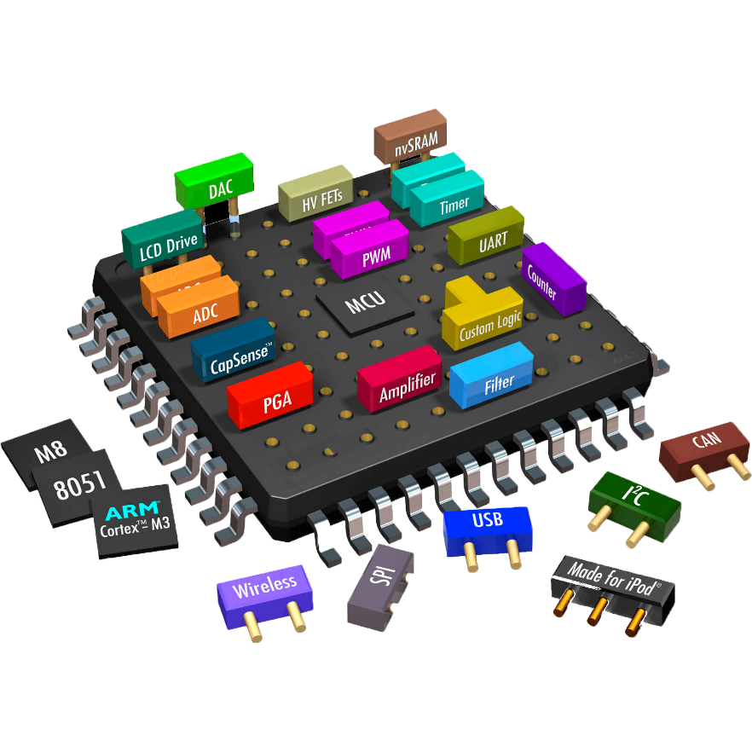

4-bit Full Adder
Presented by:
Mahdi Hasan
ID: 1802139
Babu Marma Kaywang
ID: 1802181

Slide 2
Contents
Introduction
Introduction of full adder using NAND gate
Operation of 4-bit full adder
Schematics
Symbol Design
Simulation
Layout Design
DRC run
LVS run
RCX Run
AV-extracted view
GDS export report
Conclusion

Slide 3
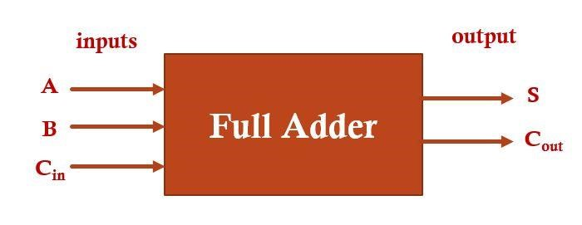
Introduction
Full Adder is the adder which adds three inputs and produces two outputs. The first two inputs are A and B and the third input is an input carry as C-IN. The output carry is designated as C-Out and the normal output is designated as S which is Sum.
A full adder logic is designed in such a manner that can take eight inputs together to create a byte-wide adder and cascade the carry bit from one adder to another.
We use a full adder because when a carry-in bit is available, another 1-bit adder must be used since a 1-bit half-adder does not take a carry-in bit. A 1-bit full adder adds three operands and generates 2-bit results.

Slide 4
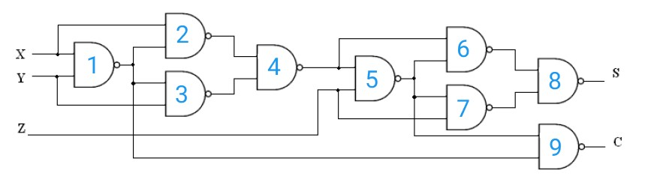
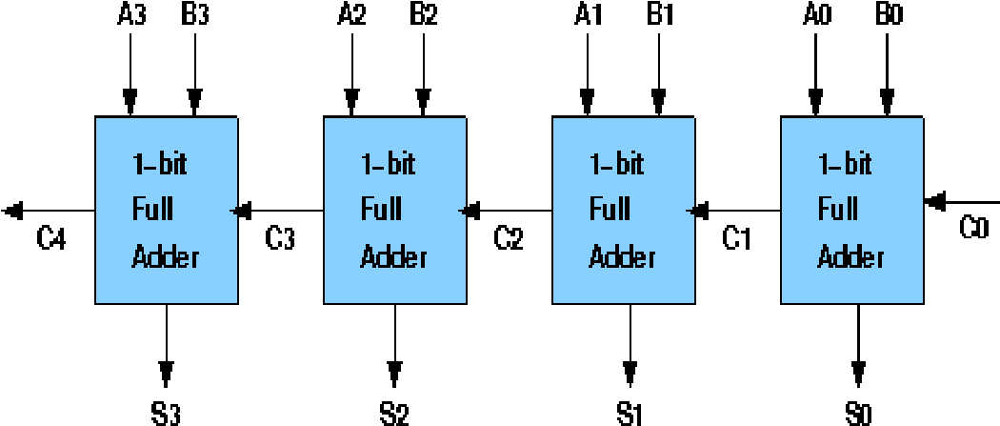
Implementation of full adder using NAND gate
Single full adder using
NAND gate
Block diagram of
4-bit full adder

Slide 5
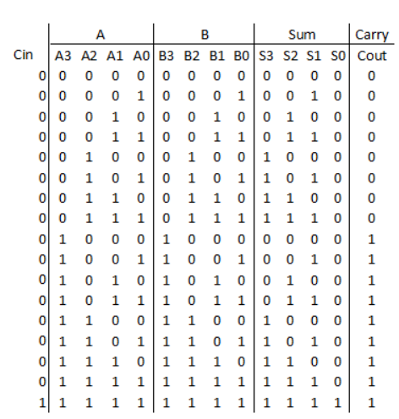
Operation of 4-bit full adder
Boolean Expressions and truth table:
For sum output,
Sum = A’B’C+A’BC’+AB’C’+ABC
For carry output,
Carray(out)= AB+BC+CA

Slide 6
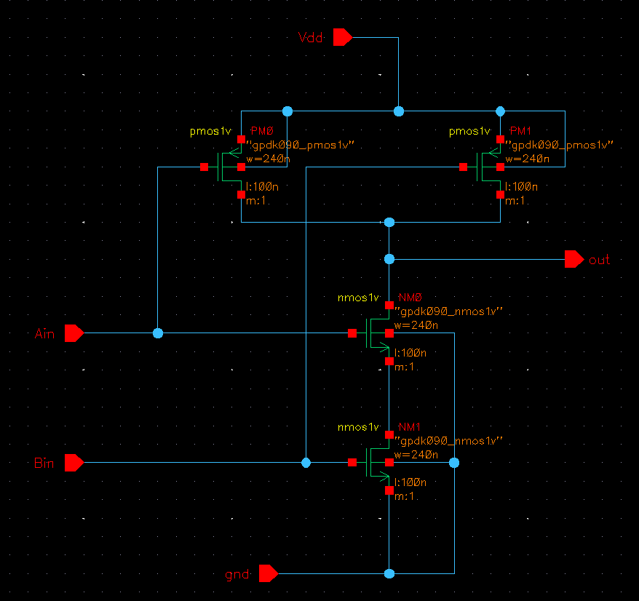
Schematics
Nand gate Schematic:
By using Command Interpreter Window (CIW), we have added the library to our library path
In our project for simplifying our design we use only NAND gate for design
First, we designed 2 input NAND gate, by using this NAND gate we designed a full adder. 9 NAND gate was required for this. And finally, by combination of four full adder a 4-but full adder was designed
Figure: Schematic diagram of a 2 input NAND Gate

Slide 7
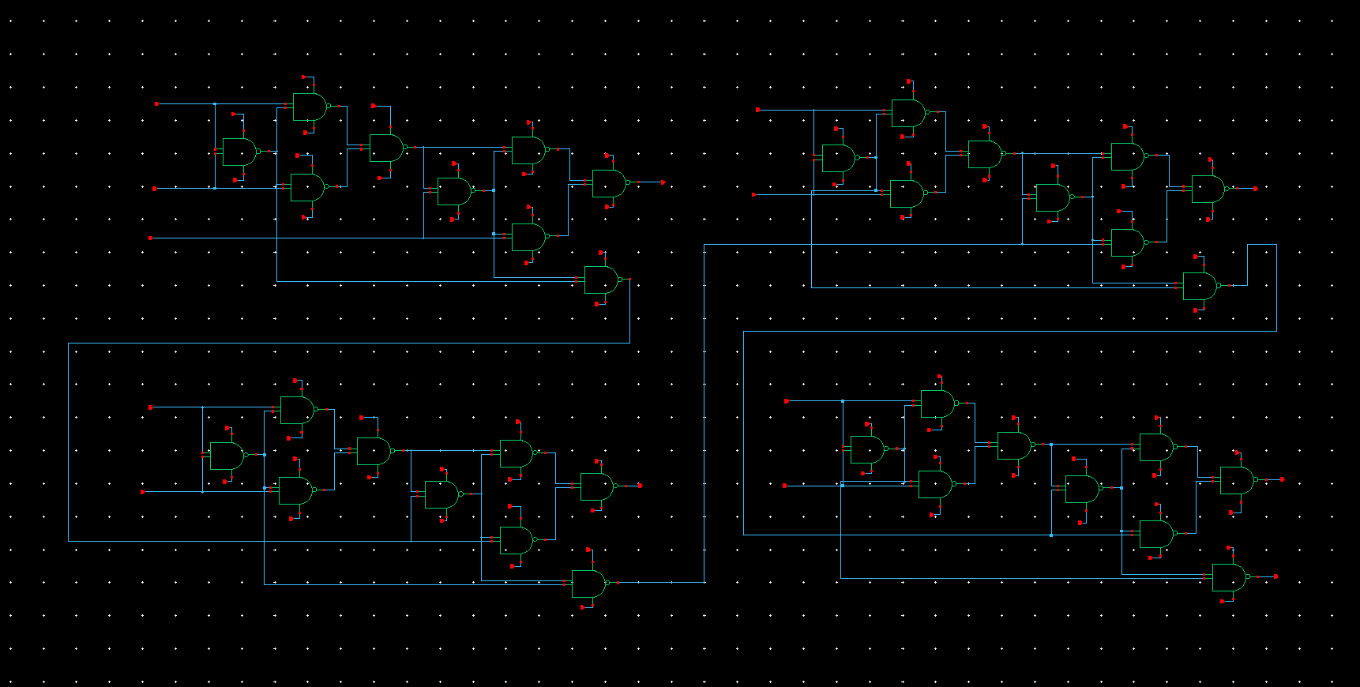
Continued….
Full adder Schematic:
By connecting ‘n’ number of full adders in series, an n-bit full Adder can be constructed.

Slide 8
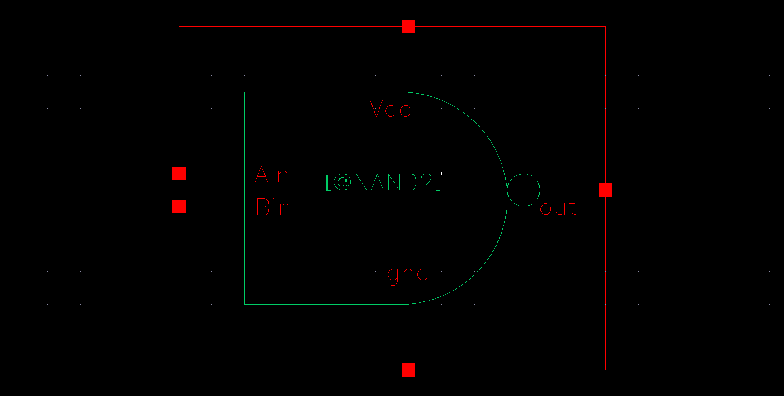
Symbol design
Nand gate Symbol:
To design the symbol, we have created another cell view. Then we have drawn the symbol of a NAND gate and four bit full adder circuit.
This symbol represent the whole 2 input NAND gate.
It is to use symbolic form than schematic.
Figure: NAND gate symbol

Slide 9
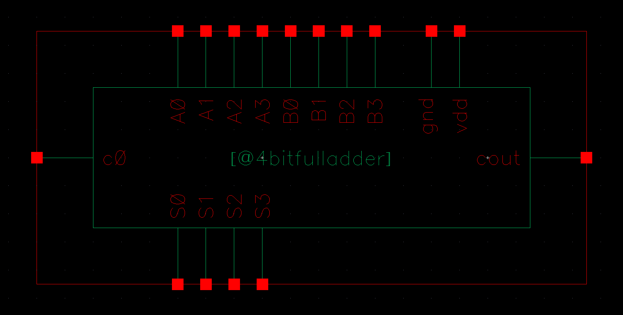
Continued….
4-bit full adder Symbol:
This symbol represent the whole input 4-bit full adder schematic. It is to use symbolic form than schematic.

Slide 10
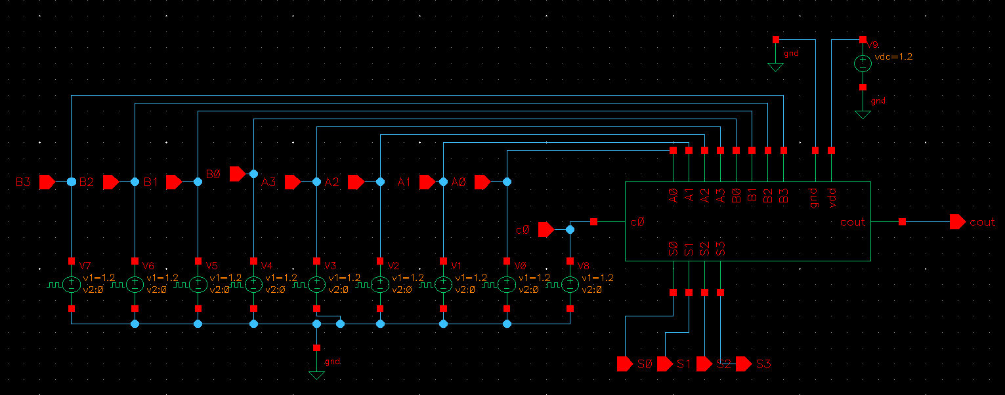
Simulation
4-bit full adder Symbol:
For simulation we fed Vpulse to input pins of the 4-bit full adder.
For our better understanding we fed different Vpulse value to the imput.
Vdd and GND are set to 1.2V and 0 V DC respectively.
Then outputs are taken from S0, S1, S2, S3 and Cout.

Slide 11
Simulation
Input:
pin | DC voltage-1 | DC voltage-2 | Rise & Fall time | Period (ns) | Pulse width (ns)
A0 | 1.2 v | 0 | 0 | 10 | 5
A1 | 1.2 v | 0 | 0 | 20 | 10
A2 | 1.2 v | 0 | 0 | 40 | 20
A3 | 1.2 v | 0 | 0 | 80 | 40
B0 | 1.2 v | 0 | 0 | 10 | 5
B1 | 1.2 v | 0 | 0 | 20 | 10
B2 | 1.2 v | 0 | 0 | 40 | 20
B3 | 1.2 v | 0 | 0 | 80 | 40
Cin | 1.2 v | 0 | 0 | 160 | 80

Slide 12
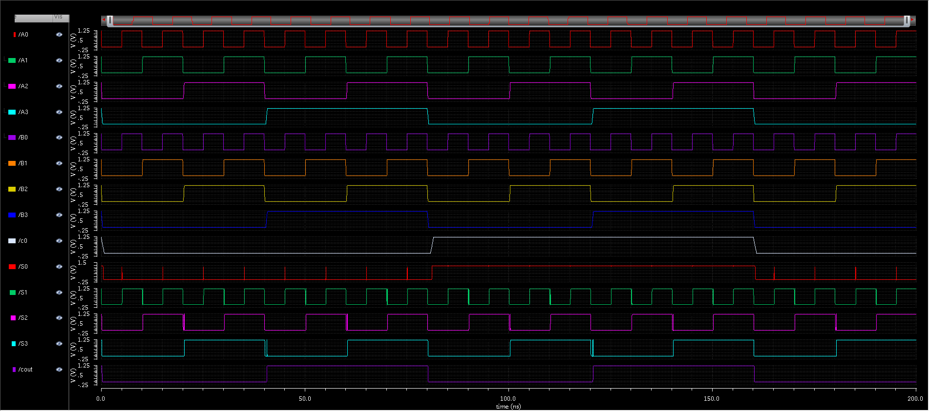
Continued….
Waveform of the simulation:

Slide 13
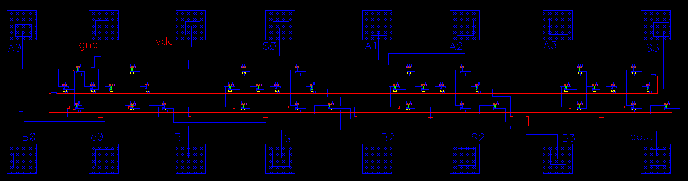
Layout design
4-bit full adder layout with I/O pad placement:

Slide 14
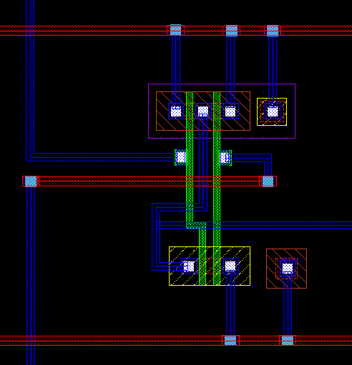
Continued….
Zooming view of layout:
The layout is combinations of 36 NAND gates.
Each NAND gate is combinations of 4 CMOS. There 2 NMOS are in series and 2 PMOS are in parallel

Slide 15
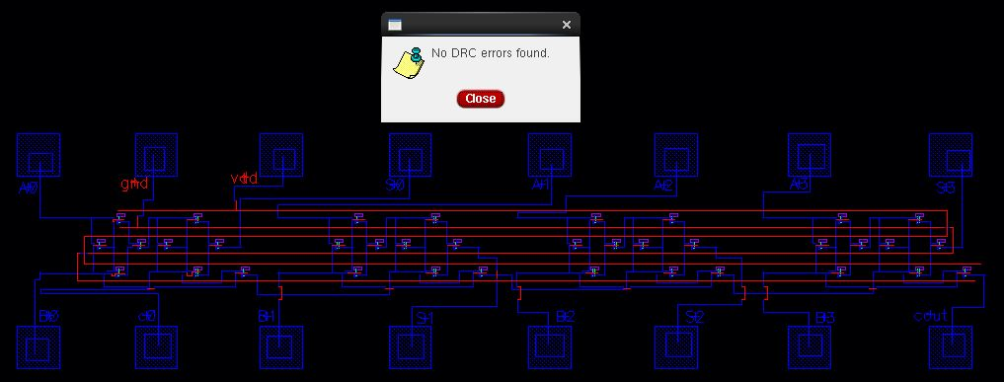
DRC run
Design Rule Check (DRC) run of the layout:
After DRC run there “No DRC error found”. That means in our layout design we maintained all the rules of a layout design in cadence.
Metal to metal line spacing, minimum line parameters, minimum area of pin requirement etc all are followed while designing the layout. That’s why “No DRC error found” window appear

Slide 16
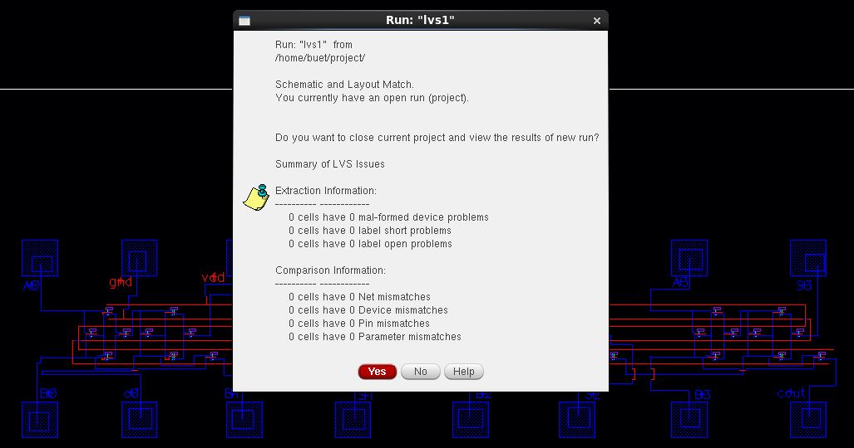
LVS run
Layout Versus Schematic (LVS) run report:
After LVS run comparison between layout and schematic window is pop-up. That window tell us in our schematic there were no mismatched between layout and schematic.
That means there were no short line, no open line, no pin mismatches, no parameters mismatches.

Slide 17
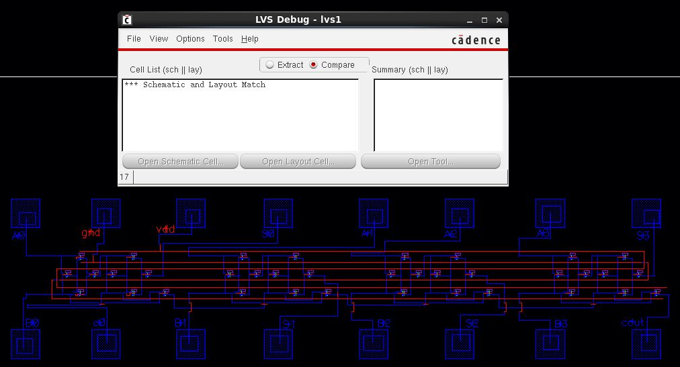
Continued….
Layout Versus Schematic (LVS) run report:
LVS debug report tell us that our designed layout and schematic are fully matched.

Slide 18
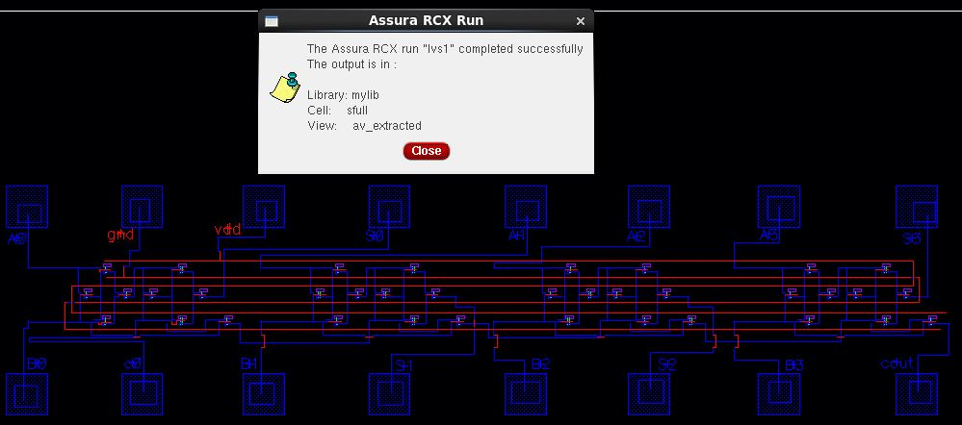
RCX run
Resistor Capacitor extraction (RCX) run report:
RCX is a process in electronic design automation (EDA) used to extract parasitic resistances and capacitances from a layout design.
The RCX process helps to accurately model the behavior of the circuit by accounting for these parasitic effects, which are crucial for understanding circuit performance, timing, and signal integrity.

Slide 19
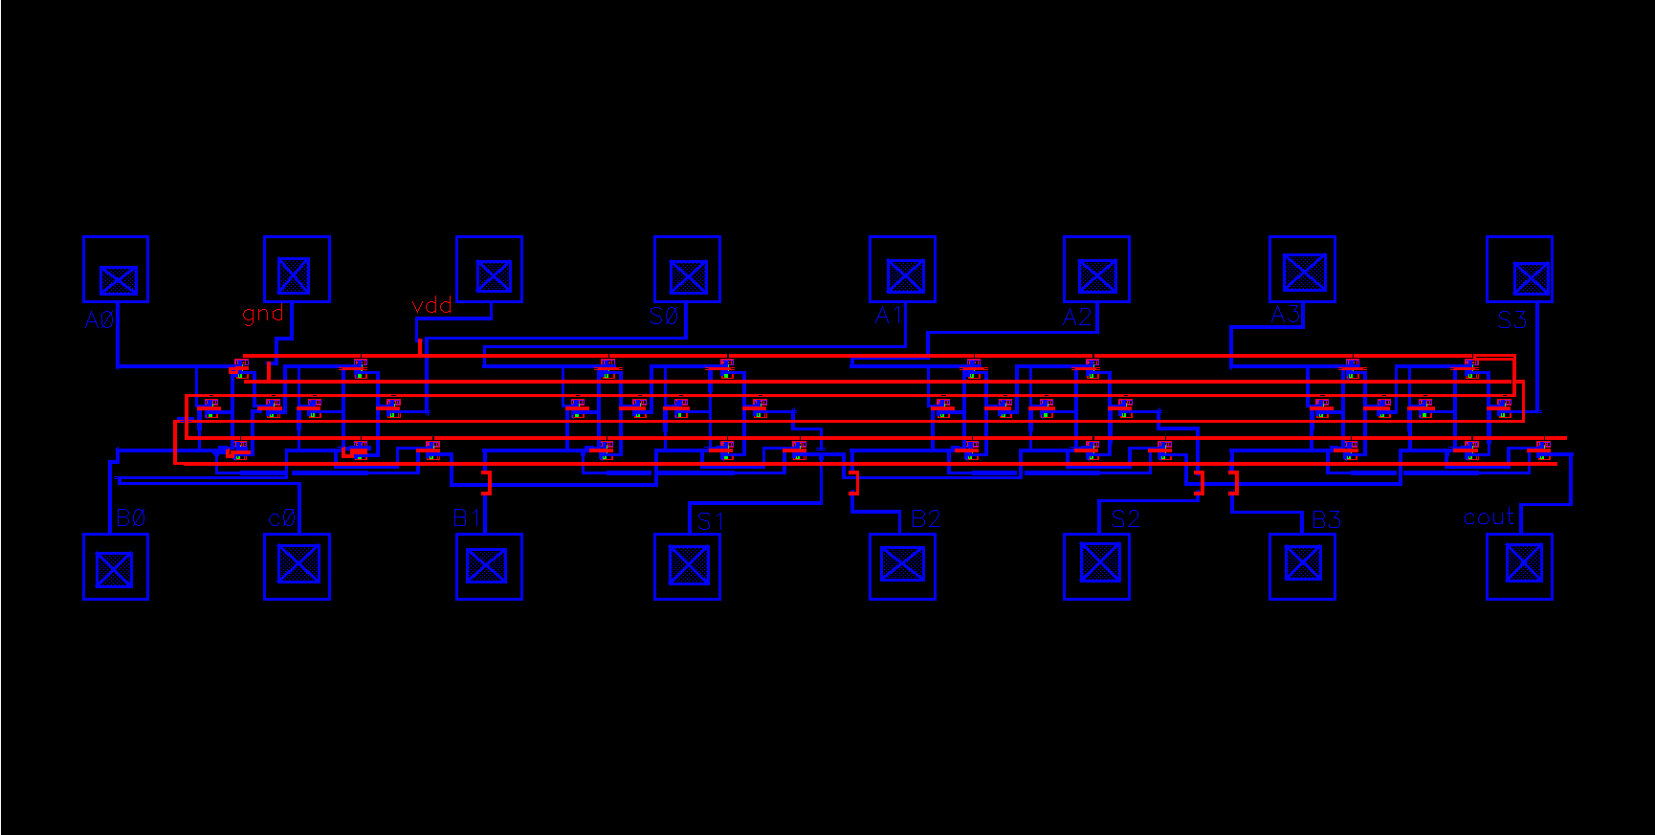
AV-Extracted view

Slide 20
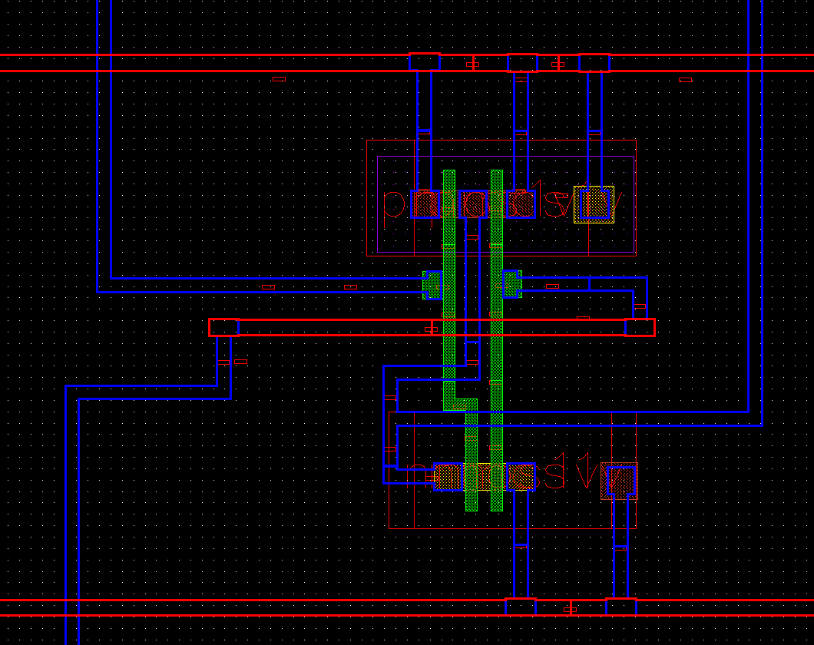
Continued….
Zooming view of av-extracted view:
Resistors and Capacitors are visible in this av-extracted view

Slide 21
Post layout simulation

Slide 22
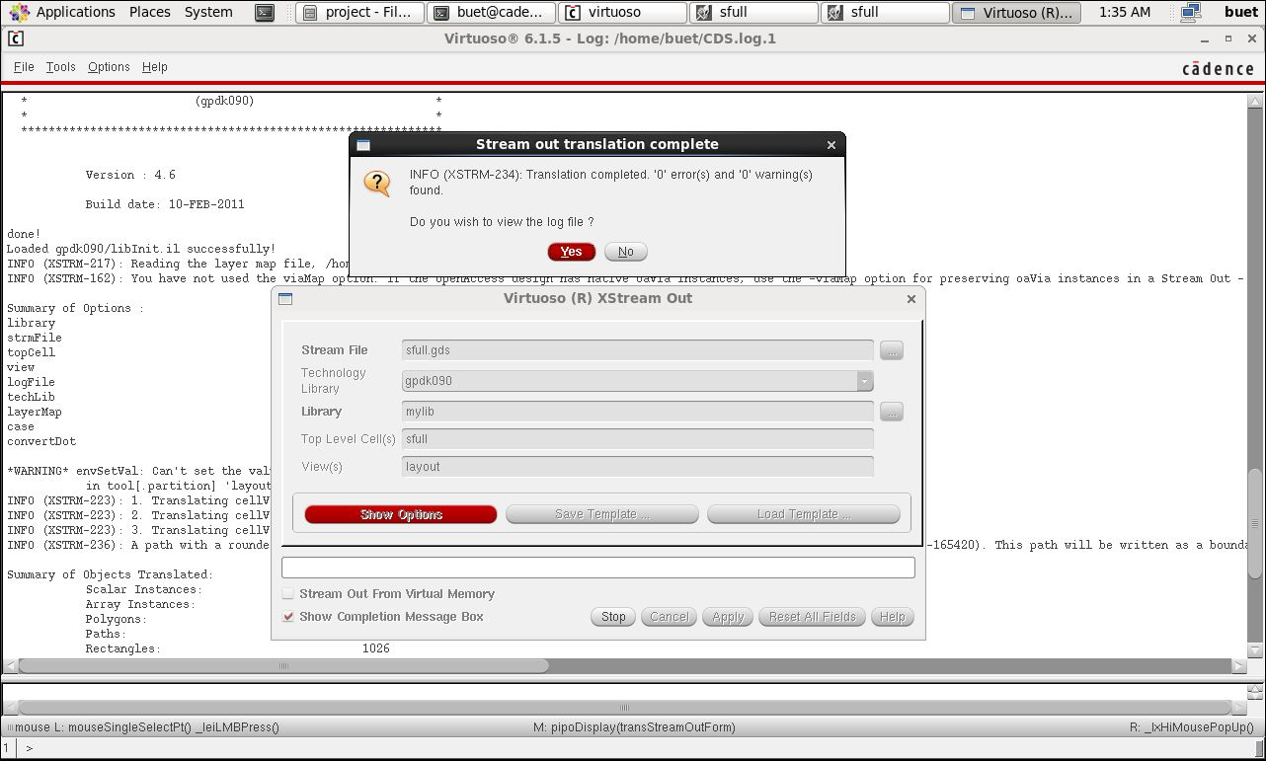
GDS export
GDS export report:

Slide 23
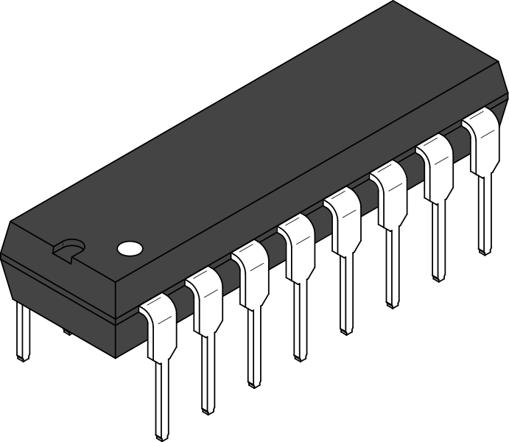
Conclusion
In conclusion we can say that, the design and implementation of the 4-bit full adder in Cadence Virtuoso represent a fundamental step in understanding digital circuit design, layout, and verification methodologies, with potential applications in more intricate systems and higher-level integrated circuits.

Slide 24




